Slide 1
CRICKET SCORE ALERT
CS8611-MINI PROJECT
Vinothini.V [821019104052]
Vishalatchi.B [821019104053]
Yuvasripriya.S [821019104054]

Slide 2
Objective
We implement the functionality which features regular updates of a cricket match live score on a Telegram group.

Slide 3
Introduction
Cricket fans, raise your foam fingers if you have been looking for a quicker way to share scores and updates with your friends.
Even if you aren’t a sports enthusiast, think about the number of fans who are out there looking for an option like this on their phones.
Sports websites do offer live scores on their page which is what the majority of the people follow to stay updated on live updates if they are not watching a match.
But the thing with these websites is that you have to keep staring at the page or refreshing it to get the latest score which can be quite unproductive if you are in the middle of important work.
Moreover, every time you want to share the joy of a SIX or a wicket withyour friend, you have to manually share it via a messaging app.
But now, you can build a better solution for the millions of sports fans (including yourself if you raised your foam finger) and even learn important concepts in that process.

Slide 4
Literature Survey
https://www.crio.do/learn/v2/me/ME_REST/
https://www.crio.do/learn/v2/me/ME_HTTP/
https://www.geeksforgeeks.org/read-write-and-parse-json-using-python/
https://www.geeksforgeeks.org/send-message-to-telegram-user-using-python/
https://www.tecmint.com/run-repeat-linux-command-every-x-seconds/
https://www.fullstackpython.com/blog/send-sms-text-messages-python.html
https://medium.com/@soufianerafik/how-to-add-a-local-project-to-github-on-macos-94a64659612b

Slide 5
Existing System
The existing system of watching cricket is generally on the television. Most matches are not scheduled on holidays and this will allow people access to the match regardless of their location. Some sites do exist that display text commentary but they are very impersonal.
Disadvantages of the existing system: -
1. Time consuming:
The manual processing is taking more time. It takes lots of time to record the process and transaction into a paper.
2. Security is not assured:
Security is not assured for the records of the organization. The need for computerizing arises in order order assure the security of the records from fire or other destruction.
3. Space consuming:
A lot of space is required to maintain the record physically. To solve the problem they are going for computerization.

Slide 6
Proposed System
The proposed system "Cricket Score Alert" is utilized by the particular player, can be viewed by a single click on their name. Main objective of the project is to develop the software for the event requirement. In this project used to maintain the details in database so easily retrieve the details from the database. This system also having the details of player and match are maintained in the repository management system.
The reports are useful to maintain the match and run rate system and complete the work as simple and as quick. Report is generated and saved in non-editable format. The proposed system commentary will be available post the match as well for review.
Advantages of the Proposed System :
➢ Easily maintain all the player details.
➢ Report generation is easier.
➢ Easy to maintain score details.
➢ Ensure user security.

Slide 7
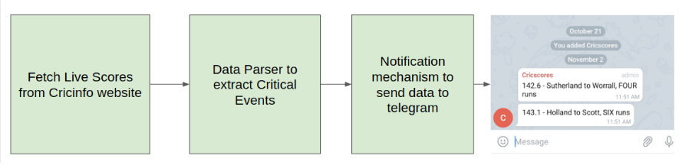
Architecture Diagram

Slide 8
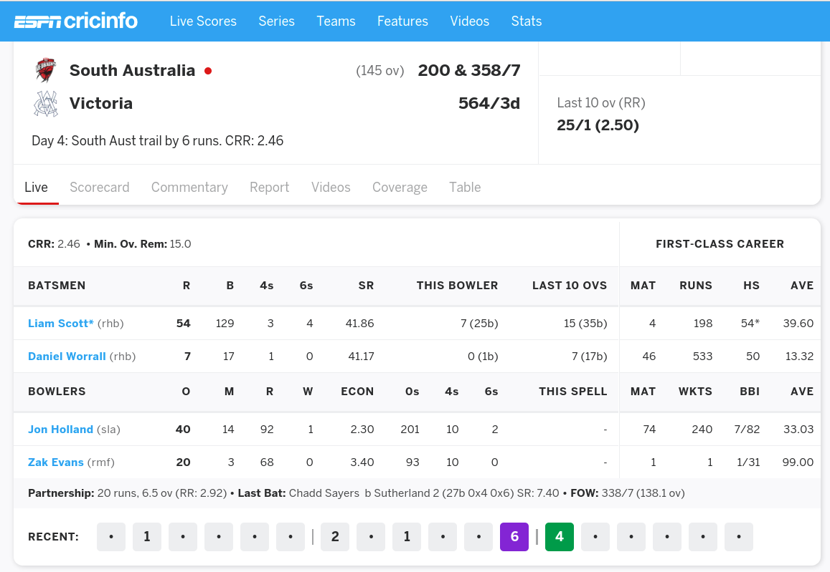
Project Modules
In this project we use python language to implement our idea on cricket score alert and exploer cricinfo website
Get the live score

Slide 9
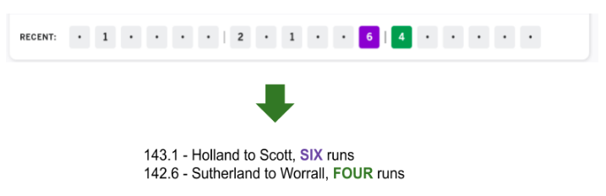
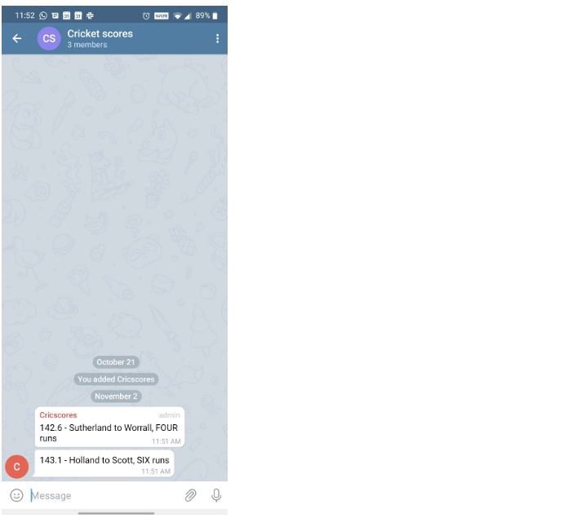
.
Extract critical events
Notification to Telegram - This is the output which is the result of this project.

